Slide 1

RESTAURANT MANAGEMENT SYSTEM
DBMS CORNERSTONE PROJECT
Presented by
Team members:
Kinthada Akshaya sri mahalakshmi
Matta Pravallika
Pachadi Jaya Sirisha
Gali Prasanna puja srry
Date of Presentation: 30-09-2026

Slide 2



PROJECT STATEMENT & NEED:
PROJECT STATEMENT:
Many restaurants still use manual methods to manage orders, customer details, billing, and employee records.
Problems:
Time-consuming
Billing errors
Data Redundancy
Difficulty maintaining records
Slow service
NEED FOR THE PROJECT:
Our system stores all restaurant data in a database, making operations faster, more accurate, and secure.

Slide 3
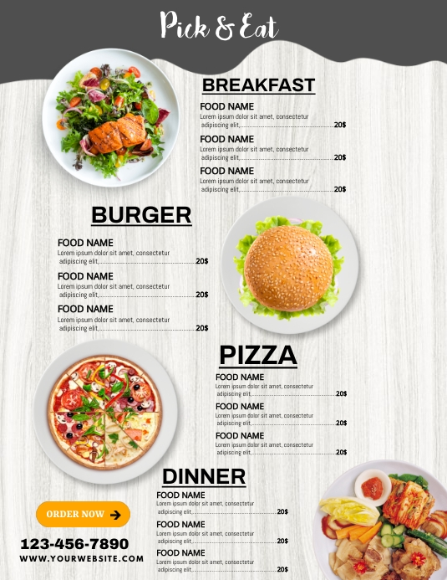
OBJECTIVES:
OBJECTIVES:
Store customer information
Manage menu items
Process customer orders
Generate bills automatically
Store payment details
Manage employee records
Reduce paperwork
Improve efficiency

Slide 4

Requirements & End Users
Functional Requirements:
Add/Edit Customer
Manage Menu
Place Orders
Generate Bills
Process Payments
Store Employee Details
Non-Functional Requirements
Security
Fast Performance
Easy to Use
Reliable Database
End Users
Restaurant Manager
Cashier
Waiter
Administrator

Slide 5
Restaurant Management System – ER Model Explanation
1. CUSTOMER:
Customer represents the people who visit the restaurant and place orders.
Customer_ID (PK): Uniquely identifies each customer.
Customer_Name: Stores the name of the customer.
Phone: Stores the customer's contact number.
Email: Stores the customer's email address.
1. CUSTOMER → ORDER
Relationship:
Customer places Order
One customer can place many orders.
CUSTOMER ───── places ─────< ORDER
1 MANY
So:
CUSTOMER : ORDER = 1 : M

Slide 6
2. EMPLOYEE:
Employee represents the restaurant staff who handle customer orders.
Emp_ID (PK): Uniquely identifies each employee.
Emp_Name: Stores the name of the employee.
Role: Specifies the employee's job role, such as waiter or manager.
Phone: Stores the employee's contact number.
Salary: Stores the employee's salary details.
2. EMPLOYEE → ORDER
Relationship:
Employee handles Order
One employee can handle many orders.
EMPLOYEE ───── handles ─────< ORDER
1 MANY
So:
EMPLOYEE : ORDER = 1 : M

Slide 7
3.ORDER:
Order represents a customer's request for food items from the restaurant.
Order_ID (PK): Uniquely identifies each order.
Order_Date: Stores the date on which the order was placed.
Total_Amount: Stores the total cost of the order.
Table_No: Identifies the restaurant table associated with the order.
Customer_ID (FK): Connects the order to the customer who placed it.
3. ORDER → ORDER_ITEM
Relationship:
Order contains Order Items
One order can contain many order items.
ORDER ───── contains ─────< ORDER_ITEM
1 MANY
So:
ORDER : ORDER_ITEM = 1 : M

Slide 8
4. PAYMENT:
Payment represents the payment made for a customer's order.
Payment_ID (PK): Uniquely identifies each payment.
Payment_Date: Stores the date on which the payment was made.
Amount: Stores the amount paid for the order.
Payment_Mode: Specifies the payment method, such as cash, card, or UPI.
Order_ID (FK): Connects the payment to the corresponding order.
ORDER → PAYMENT
Relationship:
Order has Payment
According to your PPT, one order has one payment.
ORDER ───── has ───── PAYMENT
1 1
So:
ORDER : PAYMENT = 1 : 1

Slide 9
5. ORDER_ITEM:
Order_Item represents the individual food items included in a particular order.
OrderItem_ID (PK): Uniquely identifies each order item.
Quantity: Stores the number of units of the menu item ordered.
Order_ID (FK): Connects the order item to its corresponding order.
Menu_ID (FK): Connects the order item to the selected menu item.

Slide 10
6. MENU:
Menu represents the food and beverages available in the restaurant.
Menu_ID (PK): Uniquely identifies each menu item.
Item_Name: Stores the name of the food or beverage.
Category: Specifies the type of item, such as starter, main course, or dessert.
Price: Stores the price of the menu item.
MENU → ORDER_ITEM
Relationship:
Menu Item is included in Order Item
One menu item can appear in many order items.
MENU ───── included in ─────< ORDER_ITEM
1 MANY
So:
MENU : ORDER_ITEM = 1 : M

Slide 11
7.Primary key and Foreign key:
Primary Keys (PK):-
Customer_ID → Uniquely identifies a customer.
Emp_ID → Uniquely identifies an employee.
Order_ID → Uniquely identifies an order.
Payment_ID → Uniquely identifies a payment.
OrderItem_ID → Uniquely identifies an order item.
Menu_ID → Uniquely identifies a menu item.
Foreign Keys (FK):-
Customer_ID in ORDER → Links an order to a customer.
Order_ID in PAYMENT → Links a payment to an order.
Order_ID in ORDER_ITEM → Links an order item to an order.
Menu_ID in ORDER_ITEM → Links an order item to a menu item.

Slide 12
8. Overall Working of the ER Model:
The Restaurant Management System starts with a Customer placing an Order. Each order is handled by an Employee and can contain multiple Order Items. Each order item refers to a particular Menu item. After the order is completed, the customer makes a Payment for the order. The relationships and primary/foreign keys maintain proper connections between all entities and help manage restaurant operations efficiently.

Slide 13
Entities & Attributes
Entity | Attributes
Customer | Customer_ID, Name, Phone
Order | Order_ID, Date, Total_Amount
Menu | Menu_ID, Item_Name, Price
Employee | Employee_ID, Name, Role
Payment | Payment_ID, Amount, Mode
Order_Item | OrderItem_ID, Quantity
Primary Keys
Customer_ID
Order_ID
Menu_ID
Employee_ID
Payment_ID
OrderItem_ID

Slide 14
Relationships & Cardinality
Relationship | Cardinality
Customer → Order | 1 : Many
Order → Order_Item | 1 : Many
Menu → Order_Item | 1 : Many
Employee → Order | 1 : Many
Order → Payment | 1 : 1

Slide 15
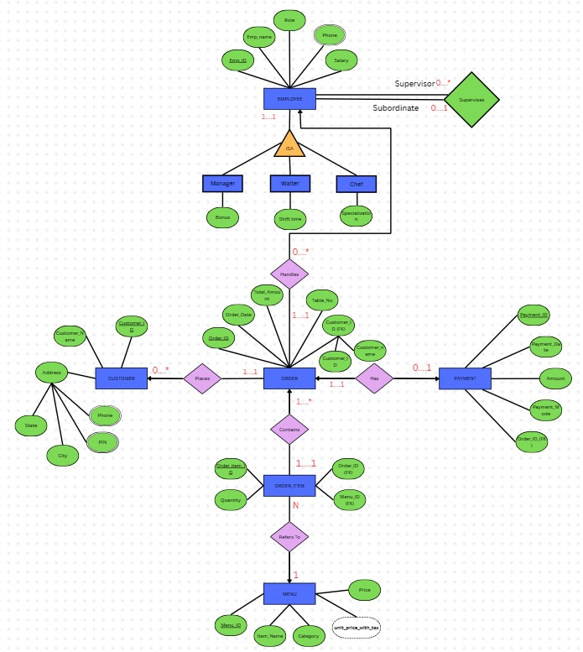
RESTAURANT MANAGEMENT SYSTEM - ER DIAGRAM

Slide 16
Database implementation
EMPLOYEE
MANAGER
WAITER
CHEF
CUSTOMER
MENU
RESTAURANT_ORDERS
PAYMENT
ORDER_ITEM

Slide 17
Other tables created
Database Tables Created:
Table | Primary Key | Important Foreign Key
Employee | Employee_id | Supervisor_id
Manager | Employee_id | Employee_id→Employee
Waiter | Employee_id | Employee_id→Employee
Chef | Employee_id | Employee_id→Employee
Customer | Customer_id | __
Menu | Menu_id | __
Restaurant_Orders | Order_id | Customer_id→Customer
Payment | Payment_id | Order_id→Orders
Order_Item | Order_item_id | Order_id→menu_id

Slide 18
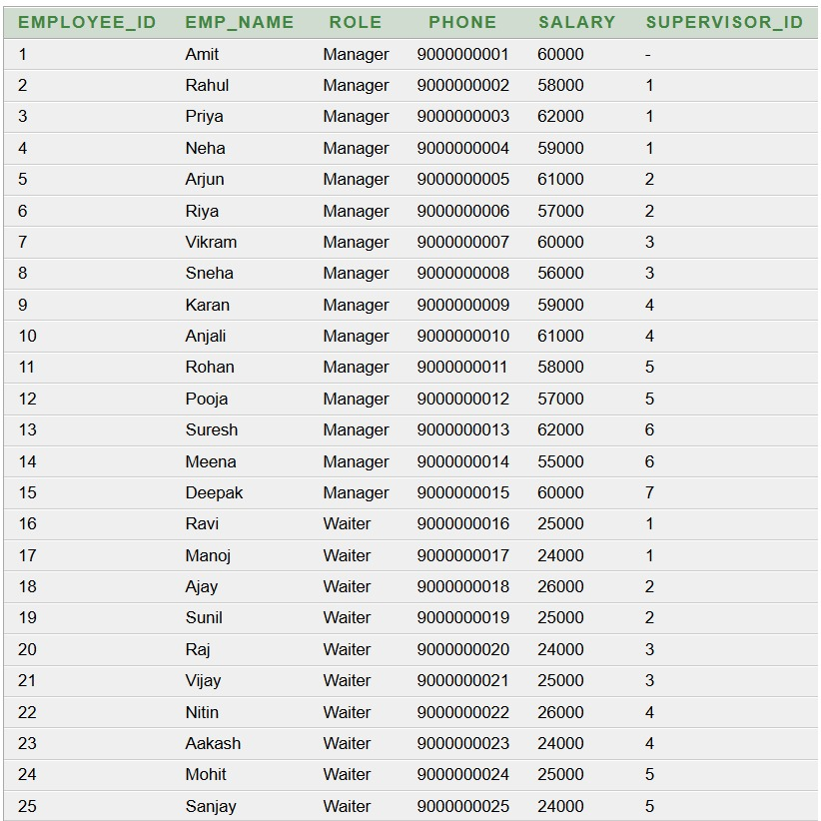
Table Creation
EMPLOYEE:
CREATE TABLE employee (
employee_id NUMBER PRIMARY KEY,
emp_name VARCHAR2(100) NOT NULL,
role VARCHAR2(20) NOT NULL,
phone VARCHAR2(15) UNIQUE,
salary NUMBER(10,2),
supervisor_id NUMBER,
CONSTRAINT fk_employee_supervisor
FOREIGN KEY (supervisor_id)
REFERENCES employee(employee_id)
);
Example:
INSERT INTO employee
(employee_id, emp_name, role, phone, salary, supervisor_id)
VALUES
(1, 'Amit', 'Manager', '9000000001', 60000, NULL);

Slide 19
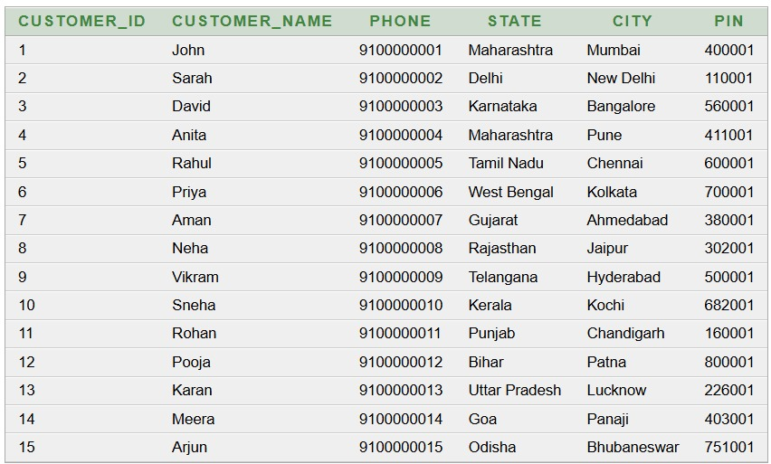
Customer table creation
Customer:
CREATE TABLE customers (
customer_id NUMBER NOT NULL,
order_id NUMBER NOT NULL,
customer_name VARCHAR2(100) NOT NULL,
phone VARCHAR2(15),
pin VARCHAR2(10),
city VARCHAR2(50),
state VARCHAR2(50),
order_date DATE,
total_amount NUMBER(10,2),
CONSTRAINT pk_customer_order
PRIMARY KEY (customer_id, order_id));
Example:
INSERT INTO customer
(customer_id, customer_name, phone, state, city, pin)
VALUES
(1, 'John', '9100000001', 'Maharashtra', 'Mumbai', '400001');

Slide 20
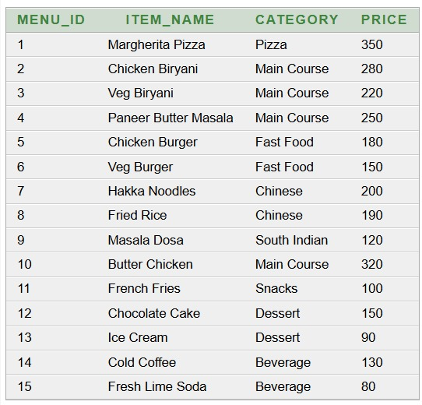
Customer table creation
Menu:
CREATE TABLE menu (
menu_id INTEGER PRIMARY KEY,
item_name VARCHAR2(100) NOT NULL,
category VARCHAR2(50),
price NUMBER(10,2)
);
Example:
INSERT INTO menu
(menu_id, item_name, category, price)
VALUES
(1, 'Margherita Pizza', 'Pizza', 350);

Slide 21
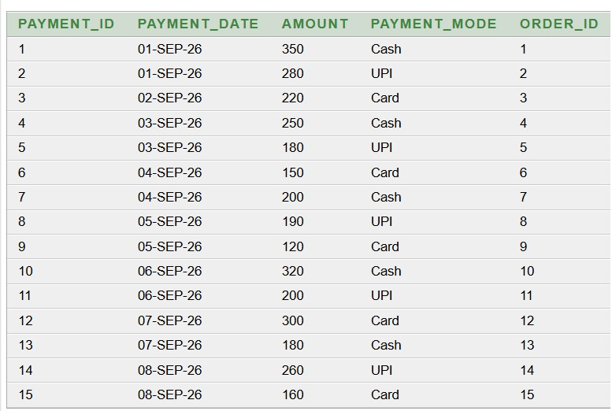
Payment table creation
Payment:
CREATE TABLE payment (
payment_id INTEGER PRIMARY KEY,
payment_date DATE,
amount NUMBER(10,2),
payment_mode VARCHAR2(30),
order_id NUMBER NOT NULL,
CONSTRAINT fk_payment_order
FOREIGN KEY (order_id)
REFERENCES restaurant_orders(order_id)
);
Example:
INSERT INTO payment
(payment_id, payment_date, amount, payment_mode, order_id)
VALUES
(1, DATE '2026-09-01', 350, 'Cash', 1);

Slide 22
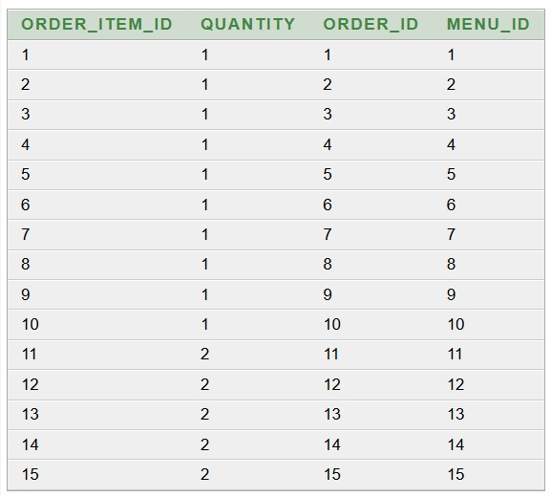
Order item table creation
Order item:
CREATE TABLE order_item (
order_item_id INTEGER PRIMARY KEY,
quantity NUMBER NOT NULL,
order_id NUMBER NOT NULL,
menu_id NUMBER NOT NULL,
CONSTRAINT fk_orderitem_order
FOREIGN KEY (order_id)
REFERENCES restaurant_orders(order_id),
CONSTRAINT fk_orderitem_menu
FOREIGN KEY (menu_id)
REFERENCES menu(menu_id)
);
Example:
INSERT INTO order_item
(order_item_id, quantity, order_id, menu_id)
VALUES
(1, 1, 1, 1);

Slide 23
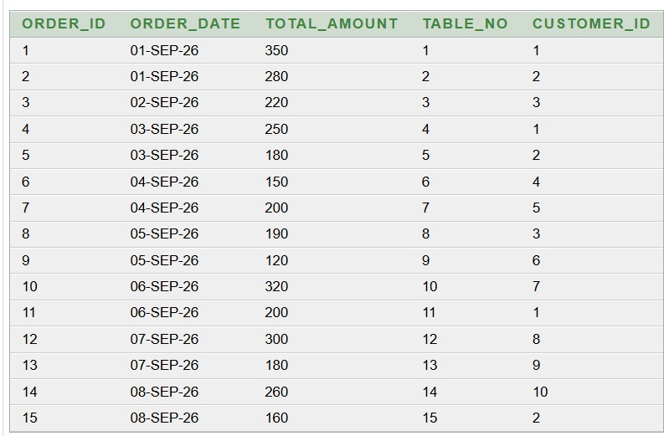
Order, payment & order item
Transaction Tables:
CREATE TABLE restaurant_orders (
order_id INTEGER PRIMARY KEY,
order_date DATE,
total_amount NUMBER(10,2),
table_no NUMBER,
customer_id NUMBER NOT NULL,
FOREIGN KEY (customer_id)
REFERENCES customer(customer_id)
);
Example:
INSERT INTO restaurant_orders
(order_id, order_date, total_amount, table_no, customer_id)
VALUES
(1, DATE '2026-09-01', 350, 1, 1);

Slide 24

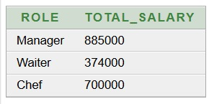
Sql queries
Question 1: Find the minimum and maximum salary of employees.
SQL Query:
SELECT MIN(salary) AS minimum_salary,
MAX(salary) AS maximum_salary
FROM employee;
Question 2: Find the total salary paid for each employee role.
SQL Query:
SELECT role,
SUM(salary) AS total_salary
FROM employee
GROUP BY role;
Output:
Output:

Slide 25
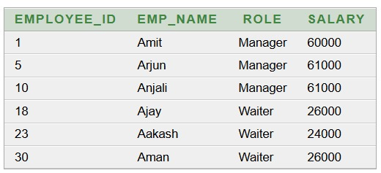
Sql queries
Question 3: Display employees whose names start with the letter 'A'.
SQL Query:
SELECT employee_id,
emp_name,
role,
salary
FROM employee
WHERE emp_name LIKE 'A%';
Output:

Slide 26
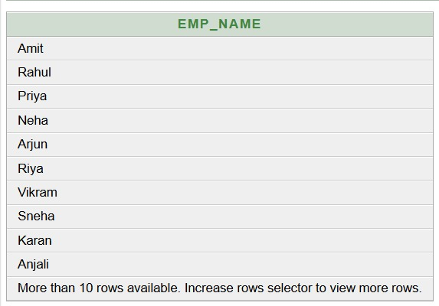

Sql queries
Question 4: Display employees whose salary is greater than 50000.
SQL Query
SELECT emp_name
FROM employee
WHERE salary > 50000;
Question 5: Find the total revenue generated from payments.
SQL Query
SELECT SUM(amount) AS total_revenue
FROM payment;
Output:
Output:

Slide 27


Sql queries
Question 6: Find the total number of orders.
SQL Query
SELECT COUNT(*) AS total_orders
FROM restaurant_orders;
Question 7: Find the highest-priced menu item.
SQL Query
SELECT * FROM menu
WHERE price = (
SELECT MAX(price)
FROM menu );
Output:
Output:

Slide 28
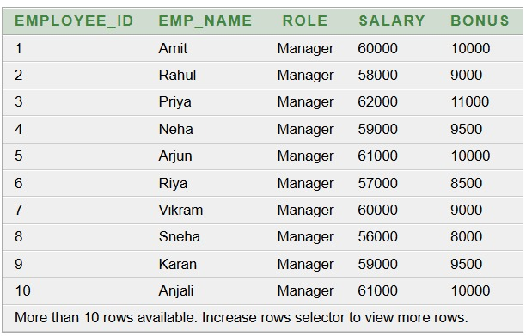
Sql queries
Question 1: Display employee details along with their manager bonus.
SQL Query:
SELECT e.employee_id,
e.emp_name,
e.role,
e.salary,
m.bonus
FROM employee e
JOIN manager m
ON e.employee_id = m.employee_id;
Output:

Slide 29
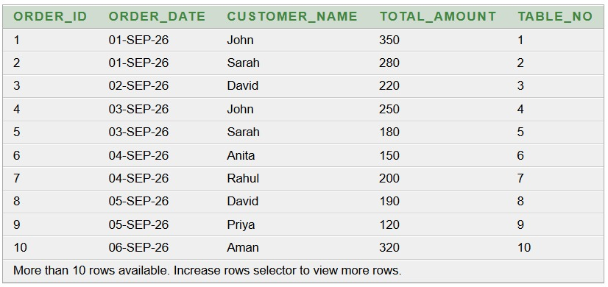
Sql queries
Question 2: Display order details along with customer names.
SQL Query
SELECT o.order_id,
o.order_date,
c.customer_name,
o.total_amount,
o.table_no
FROM restaurant_orders o
JOIN customer c
ON o.customer_id = c.customer_id;
Output:

Slide 30
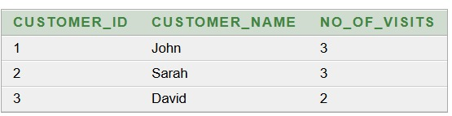
Sql queries
Question 3: Find customers who visited the restaurant more than once.
SQL Query:
SELECT c.customer_id,
c.customer_name,
COUNT(o.order_id) AS no_of_visits
FROM customer c
JOIN restaurant_orders o
ON c.customer_id = o.customer_id
GROUP BY c.customer_id, c.customer_name
HAVING COUNT(o.order_id) > 1
ORDER BY c.customer_id;
Output:

Slide 31
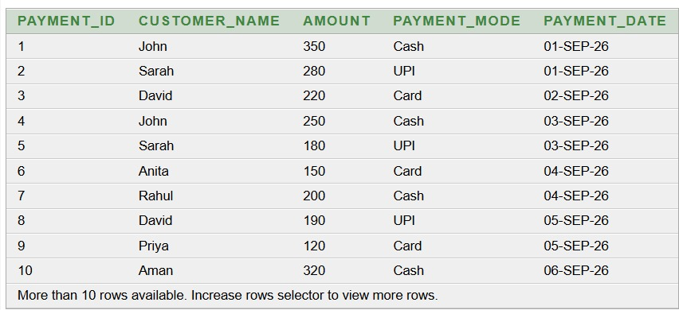
Sql queries
Question 4: Display payment details along with customer information.
SQL Query
SELECT p.payment_id,
c.customer_name,
p.amount,
p.payment_mode,
p.payment_date
FROM payment p
JOIN restaurant_orders o
ON p.order_id = o.order_id
JOIN customer c
ON o.customer_id = c.customer_id;
Output:

Slide 32
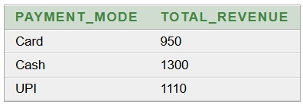
Sql queries
Question 5: Find the total revenue generated by each payment mode.
SQL Query:
SELECT payment_mode,
SUM(amount) AS total_revenue
FROM payment
GROUP BY payment_mode;
Output:

Slide 33
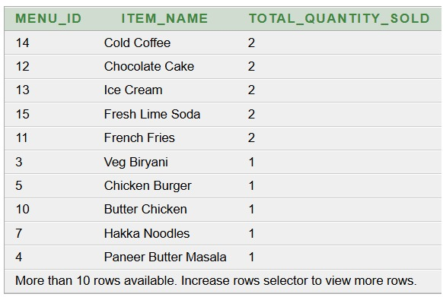
Sql queries
Question 6: Find the total quantity sold for each menu item.
SQL Query:
SELECT m.menu_id,
m.item_name,
SUM(oi.quantity) AS total_quantity_sold
FROM menu m
JOIN order_item oi
ON m.menu_id = oi.menu_id
GROUP BY m.menu_id, m.item_name
ORDER BY total_quantity_sold DESC;
Output:

Slide 34
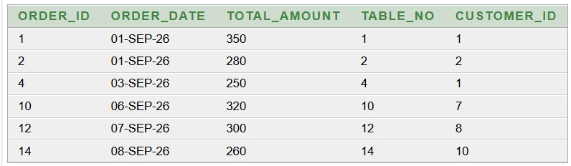
Sql queries
Question 7: Display orders whose total amount is greater than the average order amount.
SQL Query:
SELECT order_id,
order_date,
total_amount,
table_no,
customer_id
FROM restaurant_orders
WHERE total_amount > (
SELECT AVG(total_amount)
FROM restaurant_orders );
Output:

Slide 35
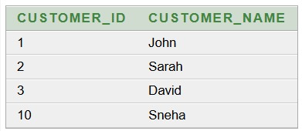
Sql queries
Question 8: Display customers who made payments using UPI.
SQL Query:
SELECT DISTINCT c.customer_id,
c.customer_name
FROM customer c
JOIN restaurant_orders o
ON c.customer_id = o.customer_id
JOIN payment p
ON o.order_id = p.order_id
WHERE p.payment_mode = 'UPI'
ORDER BY c.customer_id;
Output:

Slide 36
Normalization-1nf
Normalization of Customer Data:
Normalization is the process of organizing data into separate tables to reduce data redundancy and improve data consistency.
1NF – First Normal Form:
In our Customer table, Customer_ID, Customer_Name, Phone, PIN, City and State contain single values.
Each column contains atomic (single) values.
No multiple values are stored in one cell.
Anomalies:
1. Update Anomaly
If the location details for a PIN change, multiple customer records may need to be updated.
This can cause inconsistent data if one row is missed.
2. Insert Anomaly
We cannot easily store a new PIN, CITY, STATE combination without having a customer record.
3. Delete Anomaly
If the only customer from a particular location is deleted, the location information may also be lost.

Slide 37
DECOMPOSITION FROM 1NF TO 2NF
Conversion from 1NF to 2NF:
Primary Key: CUSTOMER_ID
Since CUSTOMER_ID is a single-column primary key, there cannot be any partial dependency.
Functional Dependencies:
CUSTOMER_ID → CUSTOMER_NAME
CUSTOMER_ID → PHONE
CUSTOMER_ID → STATE
CUSTOMER_ID → CITY
CUSTOMER_ID → PIN
Decomposition from 1NF to 2NF:
1NF CUSTOMER TABLE
↓
Check Partial Dependency
↓
CUSTOMER_ID is a single-column Primary Key
↓
No Partial Dependency
↓
2NF

Slide 38
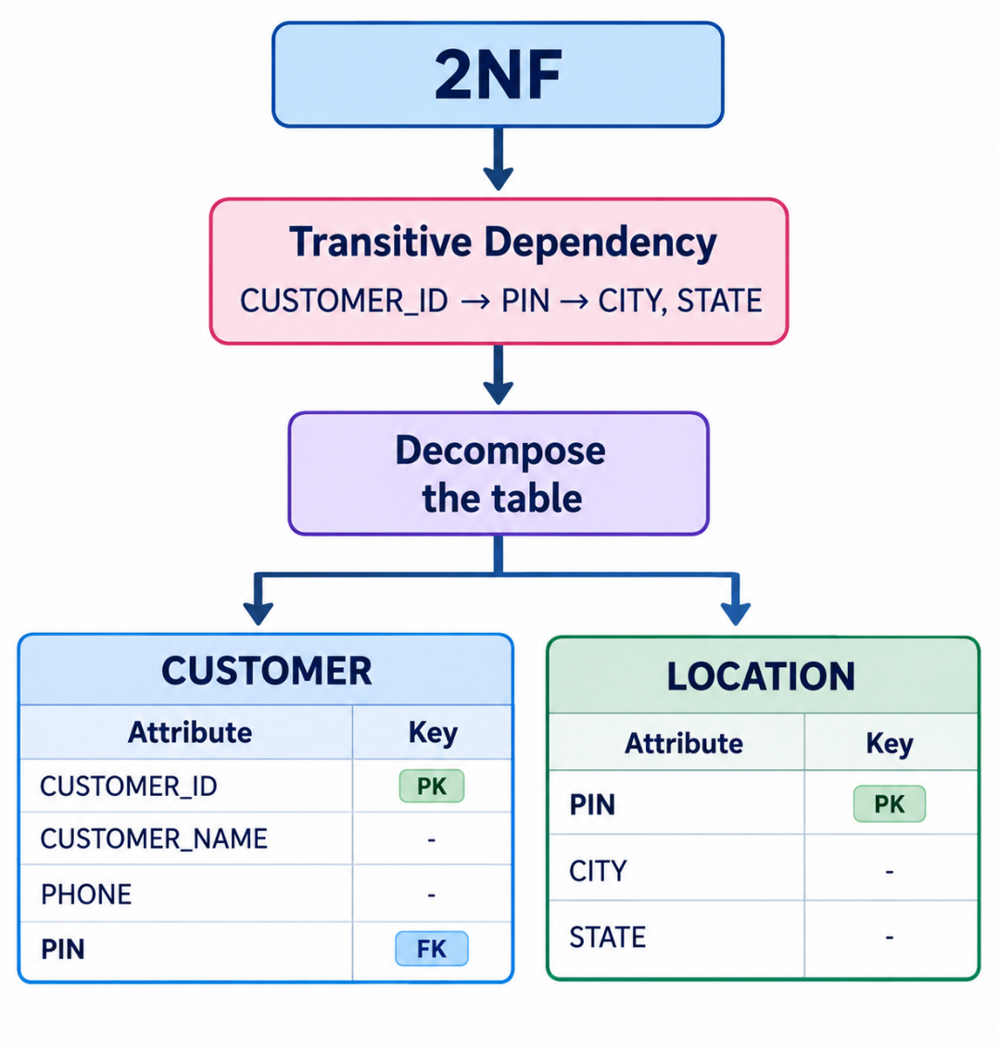
DECOMPOSITION FROM 2NF TO 3NF
Decomposition from 2NF to 3NF:
Functional Dependencies:
CUSTOMER_ID → CUSTOMER_NAME, PHONE, PIN
PIN → CITY, STATE
Therefore:
CUSTOMER_ID → PIN → CITY, STATE
Transitive Dependency:
CITY and STATE depend on PIN.
Therefore, separate the location information.

Slide 39
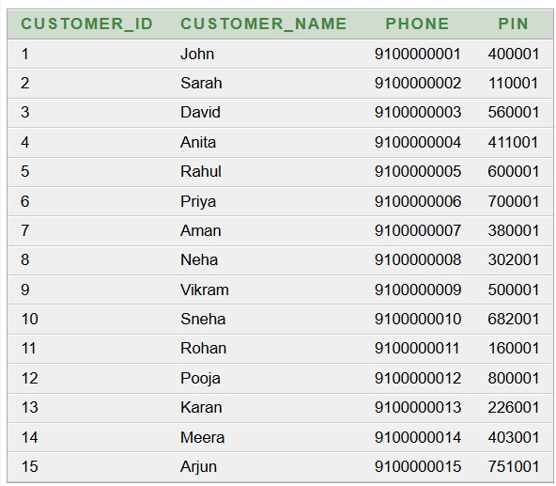
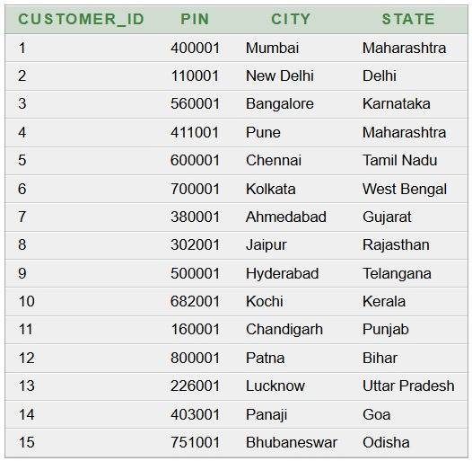
3nf decomposition
CUSTOMER:
LOCATION:
PK: CUSTOMER_ID
FK: PIN
PK: PIN

Slide 40
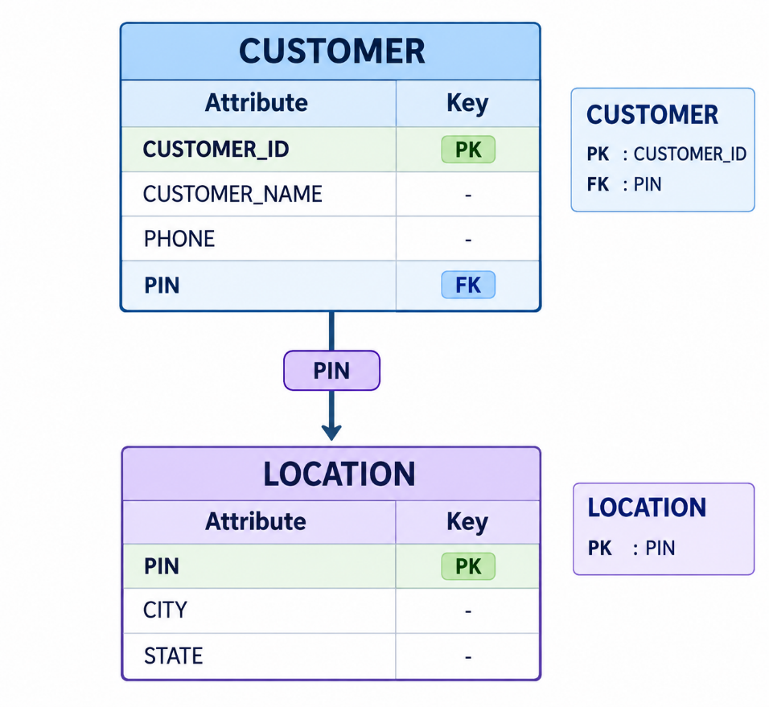
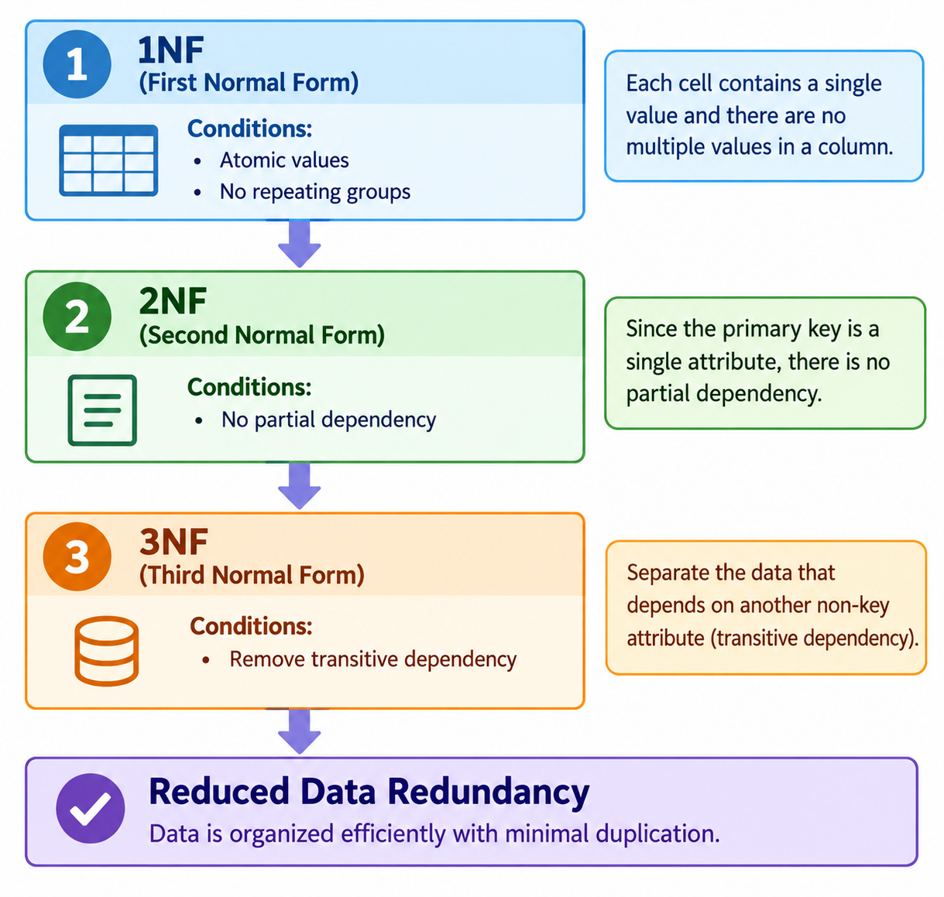
Final 3NF + Normalization Flow
Final 3NF Structure:
Normalization Process:
Result:
Transitive dependency is removed.
Location data is stored separately.
Data redundancy is reduced.
Update, insert and delete anomalies are minimized.

Slide 41
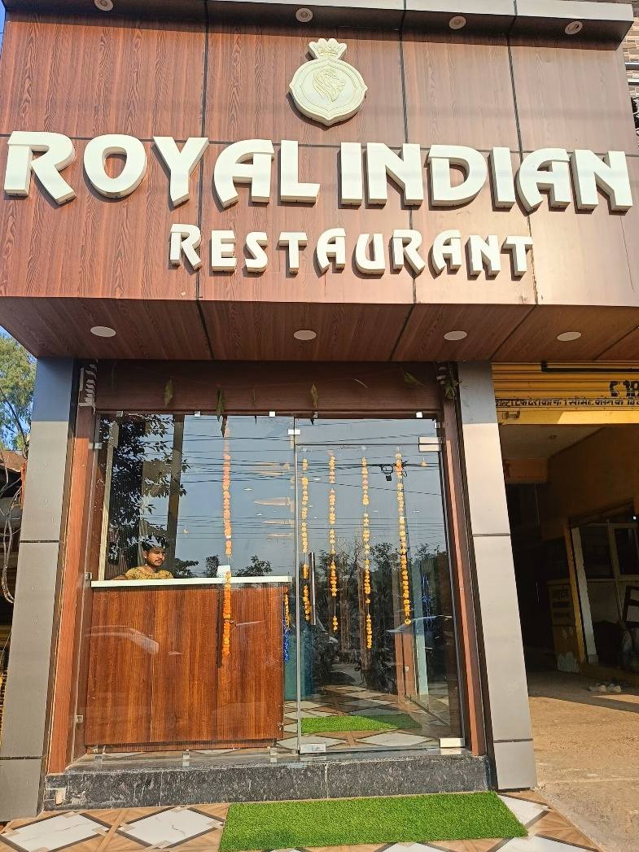
Advantages & Future Scope
ADVANTAGES:
Faster billing
Secure data
Less paperwork
Better customer service
Easy record management
Future Scope:
Online food ordering
QR Code Menu
Mobile App
Inventory Management

Slide 42
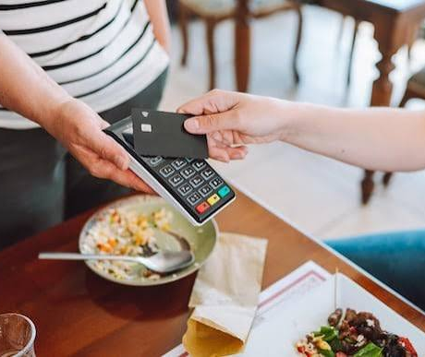
CONCLUSION
The Restaurant Management System helps restaurants manage customers, menu items, orders, employees, billing, and payments efficiently.
It reduces manual work, minimizes errors, saves time, and improves overall restaurant management.

Slide 43

Thank You

